Slide 1
Team Aegle
Project Charter & Plan
Team Members:
Joseph Finnegan
Carlos Torres
Karla Hernandez
Joe Martinez
Notes:
Carlos - don’t forget to remind people what our project actually is

Slide 2
Topics
Project Charter
MS Project Plan
Notes:
Carlos

Slide 3
Outreach Storage System Scope
What is the project?
Limitations of the project
Documentation Effort
Implementation Effort
Testing Effort
Guidelines to consider the product “finished”.

Slide 4
Customer and Audience
Sponsor: Dr. Tiernan
Consumer: Dr. Tiernan and UTA Staff / student organizations
Problem: Managing the Outreach inventory system requires a lot of manual work in order to track all the items available.

Slide 5
Cost Breakdown
Parts | Cost
Handheld RFID Reader | $600.00
RFID Tags | $20.00
Miscellaneous Items | $30.00
Plastic Crates | $40.00
Server (6 months) | $30.00
Total Cost | $720.00
Notes:
Joe

Slide 6
General Organization
•Project Manager: Karla Hernandez
•Responsibilities:
Guiding team
Main point of contact with sponsor and 3rd parties
Schedules team meetings
Conflict resolution
Notes:
Karla, Carlos & Joe prepare in case Karla doesn’t show up, slides 8 thru 12

Slide 7
Roles & Responsibilities
•Karla Hernandez
Team Lead
Architecture Lead
•Joseph Finnegan
Software Manager
Test Lead
Server Lead
Risk Manager
Notes:
Karla

Slide 8
Roles & Responsibilities, cont.
•Joe Martinez
Document Master
Database Lead
•Carlos Torres
Project Planner
Hardware Lead
•Dr. Tiernan
Project Sponsor
Provide feedback
Notes:
Karla

Slide 9
Communication Plan
Internal
Regular team meetings
Whats App mobile app
Email
GitHub
External
Sponsor Meetings
Email
Notes:
Joe

Slide 10
Project Oversight
• Team has agreed to have all major deliverables finished one week before due date
• Documents in progress are hosted on GitHub for version control
• Team uses What’s App to communicate informally outside of meetings
Notes:
Karla,

Slide 11
MS Project Plan
Task Breakdown & Estimation
Keeping Track of Progress
Overview of the Project Plan
Updates to the Project Plan
Notes:
Carlos

Slide 12
Task Breakdown & Estimation
Previous SD documents are analyzed
Task are assigned according to team member’s strengths and complexity
Team has a internal deadline of a week before the external deadline
Notes:
Complexity based on previous Projects.

Slide 13
Estimation
Roughly 15 Hours per Week per Person
Around 1920 Hours Total to Complete Project
Estimate Doesn’t Take into Account Other Team Member’s Commitments

Slide 14
Keeping Track of Progress
The following are use to keep track of progress:
Baseline and Actual Start/Finish
Resource Name
BCWS (Budgeted Cost of Work Scheduled)
ACWP (Actual Cost of Work Performed)
BCWP (Budgeted Cost of Work Performed)
CPI (Cost Performance Index)
SPI (Schedule Performance Index)

Slide 15
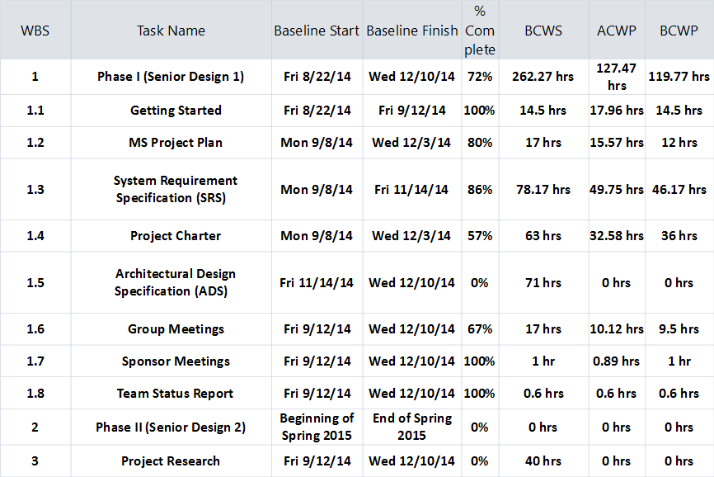
Overview of the Project Plan
Notes:
Carlos

Slide 16
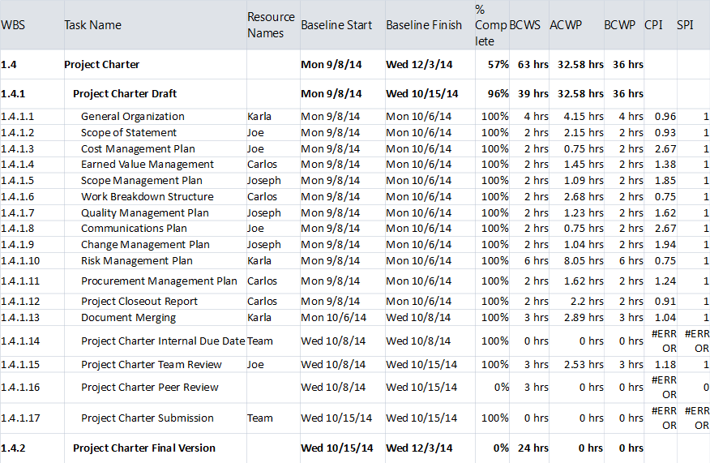
Overview of the Project Plan
Notes:
Carlos

Slide 17
Updates to Plan
Biweekly Meetings
- Tuesdays and Saturdays
- Report progress and update project plan
Updates after any progress
Notes:
Carlos

Slide 18
Project Person-hours Budget
Approximately 6-7 months to complete project
Each person works 15 hours per week
As a 4 man team, this is 1440-1680 hours total over the life of the project
Notes:
Joe

Slide 19
Change Control
Used after detailed design has already begun
Any change must be submitted with a change proposal form
Team must decide if change is important enough to be implemented
Team must revise all design, specification, and planning documents to include change
Notes:
Joseph

Slide 20
Quality Management
Documentation
Kept on GitHub for version control
Final versions stored on Google Drive
Rough drafts reviewed by document master
Software
Test driven development
Consumer inclusion
Notes:
Joseph

Slide 21
Quality Management, cont.
Hardware
Will be evaluated by the entire team
Each piece of hardware will be assigned a weighted value by team
Testing
Software will be unit tested as it is being developed
Hardware will be tested before it is integrated with software
After individual testing, both software and hardware will be integrated and tested
Notes:
Joseph

Slide 22
Change Management
Roles & Responsibilities
Project Sponsor
Will propose/approve any significant changes
Proposal must be submitted to team with a change request form
Must meet with team to discuss proposed change
Project Manager
Primary point of contact for 3rd parties wishing to contact team
May use discretion concerning change proposals
Notes:
Joseph

Slide 23
Change Management, cont.
Project Team
Discuss and analyze proposed changes
Estimate additional effort and monetary cost needed
Team must come to unanimous decision for change
Mr. O’Dell
Will be notified of approved changes
Thoughts will be taken into consideration concerning final change approval
Notes:
Joseph

Slide 24
Change Request Form
Source of Change
Date of Change Request Submission
Description of Change
Justification of Change
Areas for sponsor and team signatures
Notes:
Joseph

Slide 25
Risk Management
Roles & Responsibilities
Project Sponsor
Risk Identification from client’s POV
Project Manager
Maintain communication with risk manager
Guiding team and avoiding critical risks
Notes:
Karla

Slide 26
Risk Management, cont.
Project Team
Responsible for identifying risks
Must follow steps stated in risk management plan
Risk Manager
Joseph Finnegan is designated Risk Manager
Will document and keep track of risks that emerge during development
Monitor risk mitigation process
Notes:
Karla

Slide 27
Risk | Priority | Resolution | Trigger
Choose Correct RFID reader | High | Learn about RFID technology and possibly borrow a testing reader from Dr. Jones | Lack of knowledge related to RFID technology.
Tracking items in the storage room is an unrealistic requirement. | High | Find a technology work around so that we don’t exceed the budget. | Sponsor defines unrealistic requirements.
Lack of RFID technology | High | Dr. Jones Students will train us on RFID technology topics. | Identifying the use of the unknown technology in the requirements phase.
Underestimation of tasks | Medium | Have an internal calendar with early due dates so that we have time in case of a contingency. | Tendency of the team to underestimate hours for the tasks.
Other Work | Low | Distribute the work among the remaining team members. | Team members require to miss a meeting or get assigned extra course work.
Incorrect Project Design | High | Consult with several individuals the correctness of our ADS before turning in the baseline document. | Confusion on how to design the Architecture of the system.
Notes:
Karla

Slide 28
Process To follow
Once a trigger occurs, the team will gather and identify the possible Risk(s) that it will cause
Depending on the severity of the risk the team will either deal with the risk, but mainly avoid it following the resolution plan.
The risk manager will documented all activities / issues and resolutions as well as after mitigation

Slide 29
Procurement Management
Roles & Responsibility
Project Sponsor
Provide suggestions/advice concerning components and services needed
Project Manager
Will make final decision on which components and services will be purchased
Notes:
Joe

Slide 30
Procurement Management, cont.
Project Team
Will provide project manager with their opinions concerning components/services needed
Responsible for researching components and services needed
Mr. O’Dell
Will make final decision as to which components and services are purchased
Notes:
Joe

Slide 31
Procurement & Timing
Components and services needed will be procured at least 2 weeks in advance
To ensure that all components and services are ready before implementation
Notes:
Joe

Slide 32

Questions?

